Slide 1

Computational Physics (PHYS6350)
Lecture 18: Random numbers and Monte Carlo methods part II
March 30, 2023
Instructor: Volodymyr Vovchenko (vvovchenko@uh.edu)
Course materials: https://github.com/vlvovch/PHYS6350-ComputationalPhysics

Slide 2
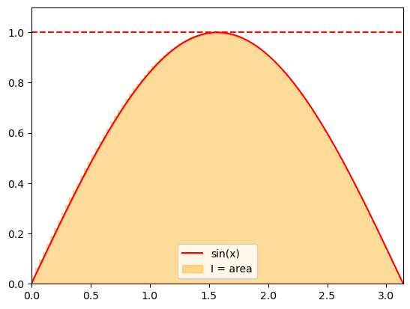
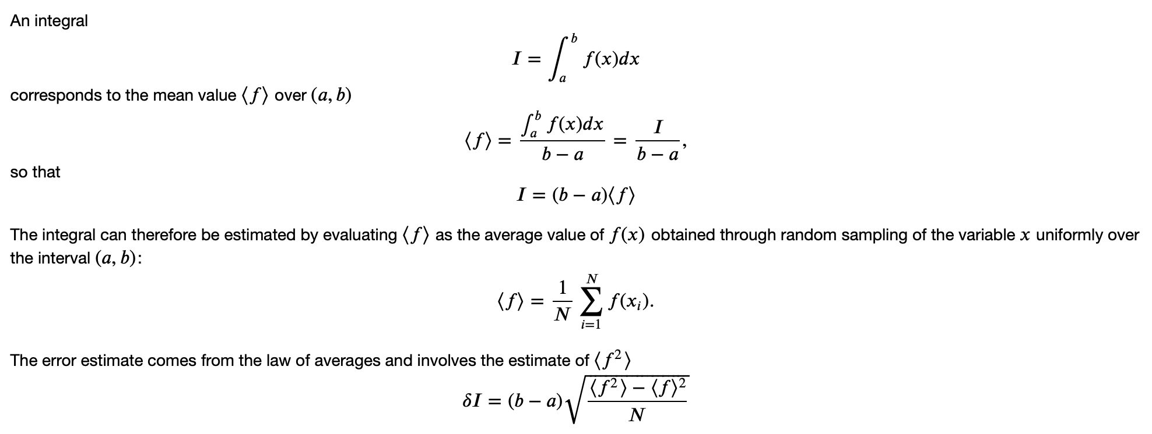
Computing integral as the average
From previous lecture
How about multi-dimensional integrals?

Slide 3
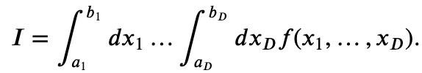
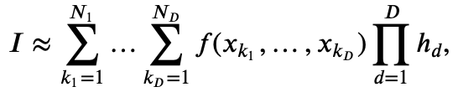
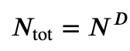
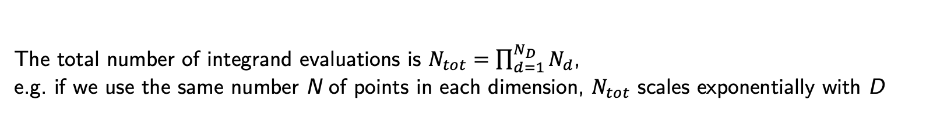
Computing multi-dimensional integrals
Monte Carlo methods really shine when it comes to numerical evaluation of integrals in multiple dimensions.
Consider the following D-dimensional integral
Computing it numerically using for instance the rectangle rule would involve the evaluation of a multi-dimensional sum
where
The total number of integrand evaluations is $N_{tot}=\prod_{d=1}^{N_{D}}{N_{d}}$,
e.g. if we use the same number N of points in each dimension, $N_{tot}$ scales exponentially with D
curse of dimensionality

Slide 4
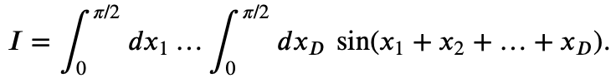
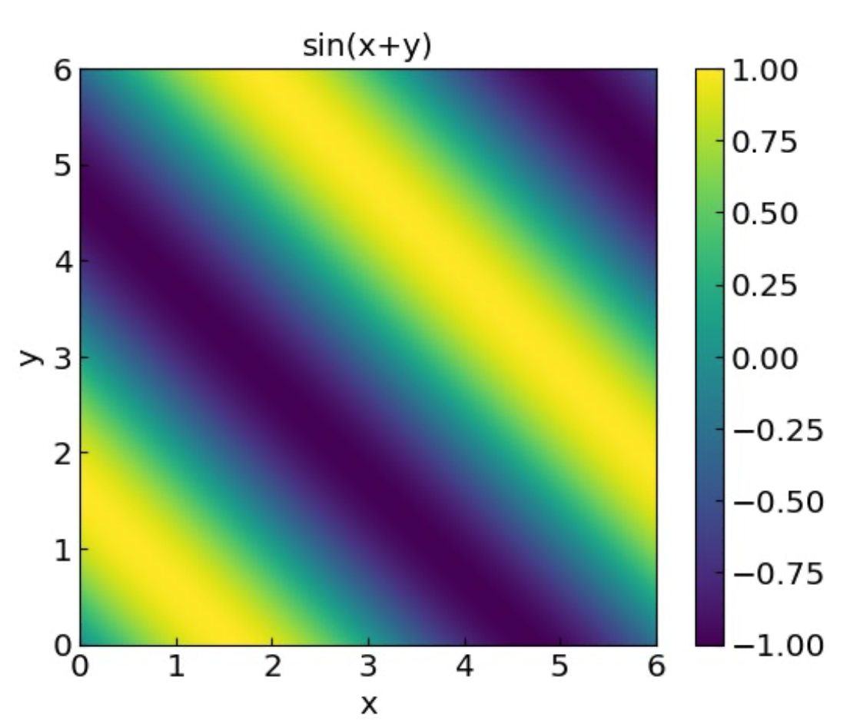
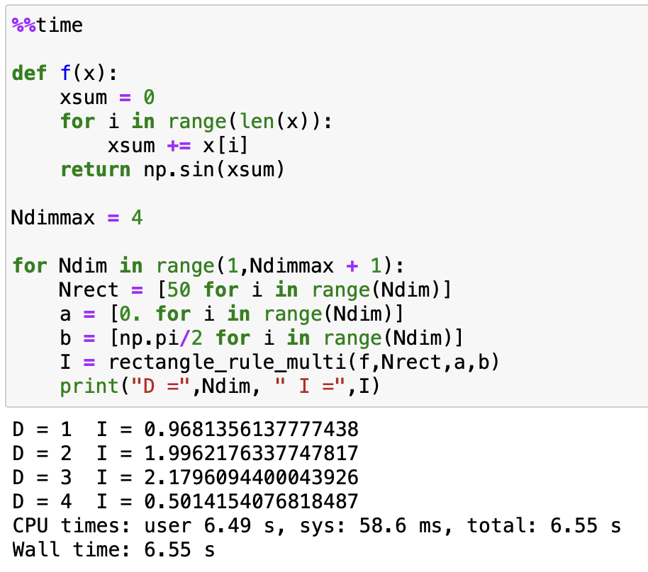
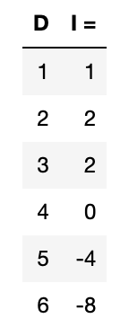
Computing multi-dimensional integrals: Example
Applying the rectangle rule we get:
Analytic result:
Not very accurate if we want reasonable runtime for D > 3

Slide 5
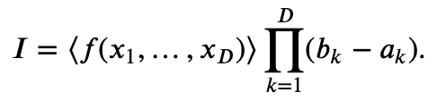
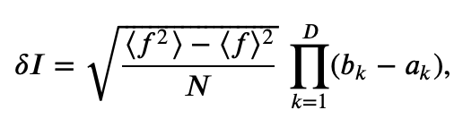
Computing multi-dimensional integrals: Monte Carlo
Similar to 1D case, replace
by the mean
Here x₁,…,x_{D} are independent random variables distributed uniformly in intervals x_{k} in [a_{k},b_{k}].
Error estimate:
Increasing the number of dimensions by one: sample one more number each iteration.
linear complexity in D

Slide 6
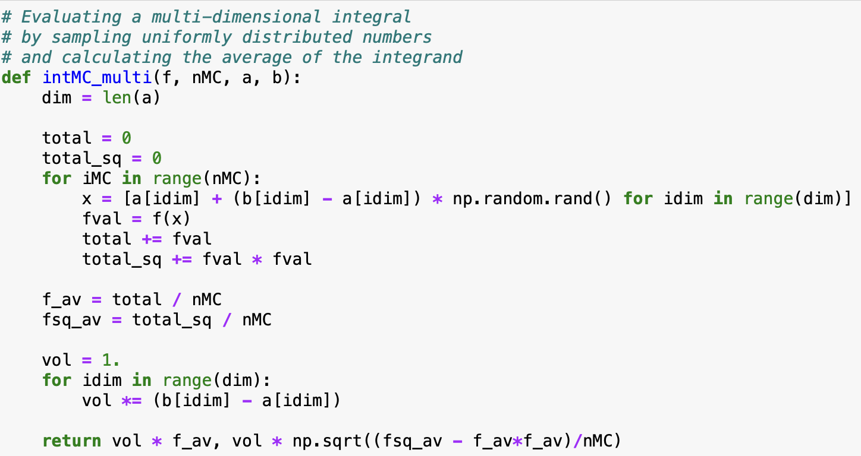
Computing multi-dimensional integrals: Monte Carlo
Implementation:

Slide 7
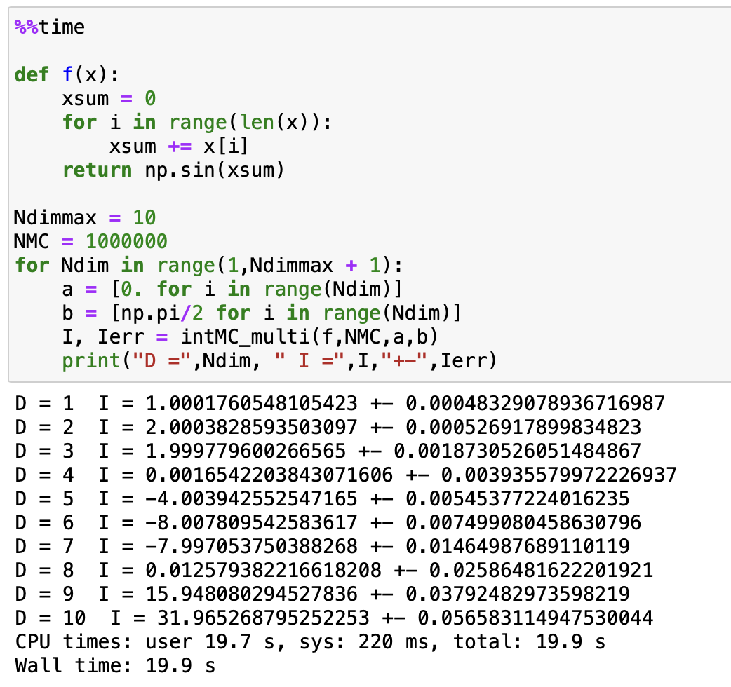
Computing multi-dimensional integrals: Monte Carlo
Our example:
Analytic result:

Slide 8
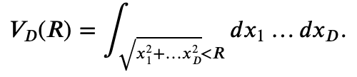
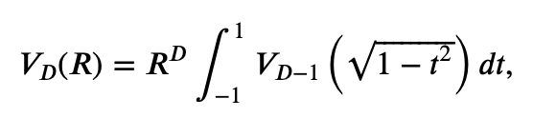
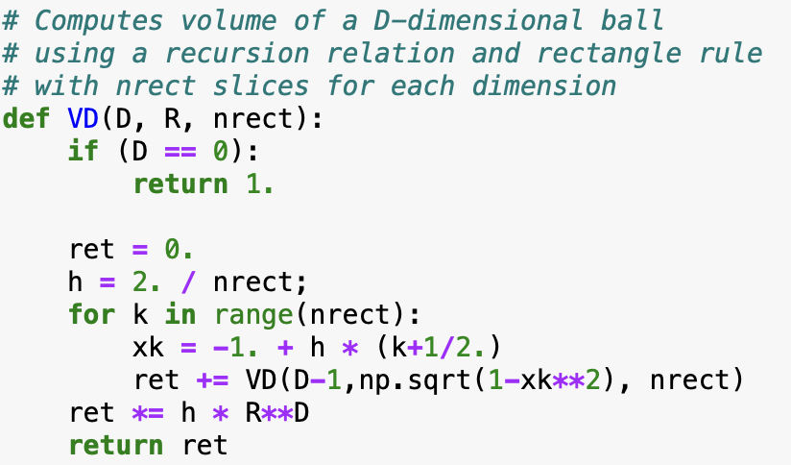
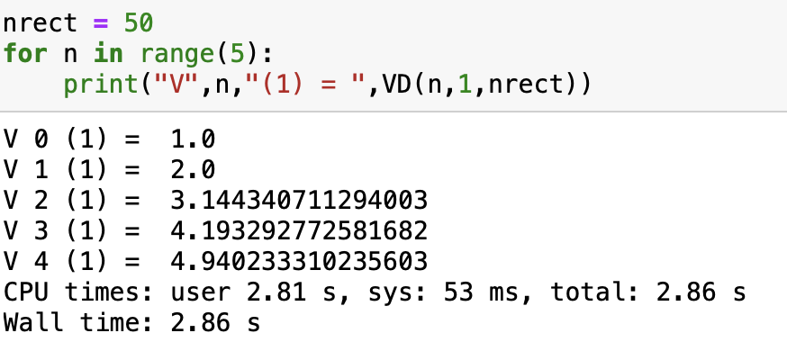
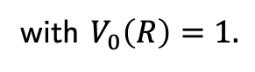
Volume of a D-dimensional ball (hypersphere)
Let us consider an D-dimensional ball of radius R.
Its volume is given by a D-dimensional integral
This can be written with the recursion formula
with $V_{0}\left(R\right)=1.$
Rectangle (non-MC) method (recursive)

Slide 9
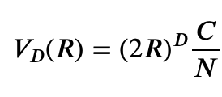
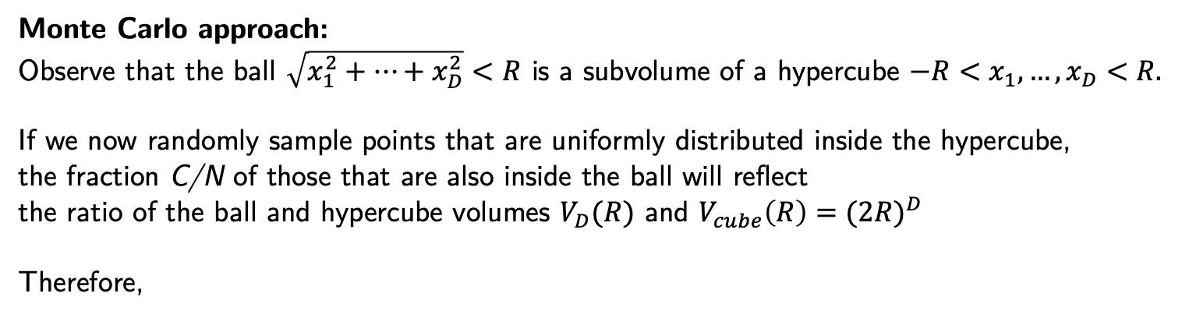
Volume of a D-dimensional ball (hypersphere)
Monte Carlo approach:
Observe that the ball $\sqrt{x_{1}^{2}+…+x_{D}^{2}}<R$ is a subvolume of a hypercube $−R<x_{1},…,x_{D}<R.$
If we now randomly sample points that are uniformly distributed inside the hypercube,
the fraction C/N of those that are also inside the ball will reflect
the ratio of the ball and hypercube volumes $V_{D}(R)$ and $V_{cube}\left(R\right)={(2R)}^{D}$
Therefore,

Slide 10
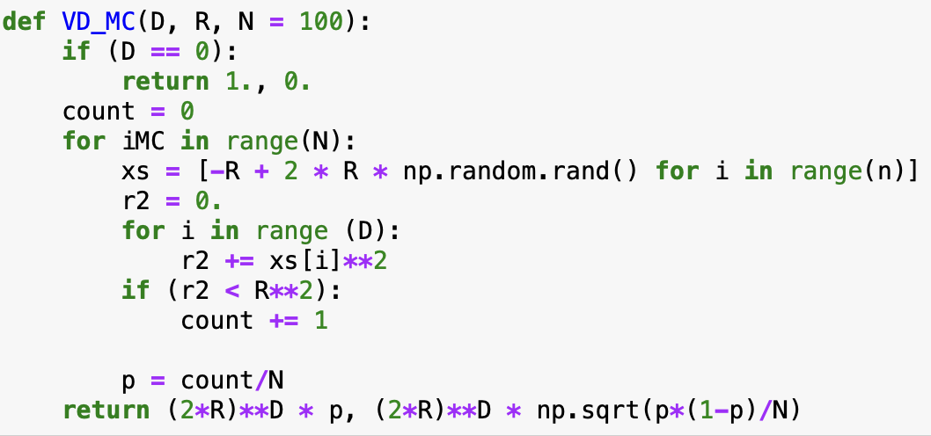
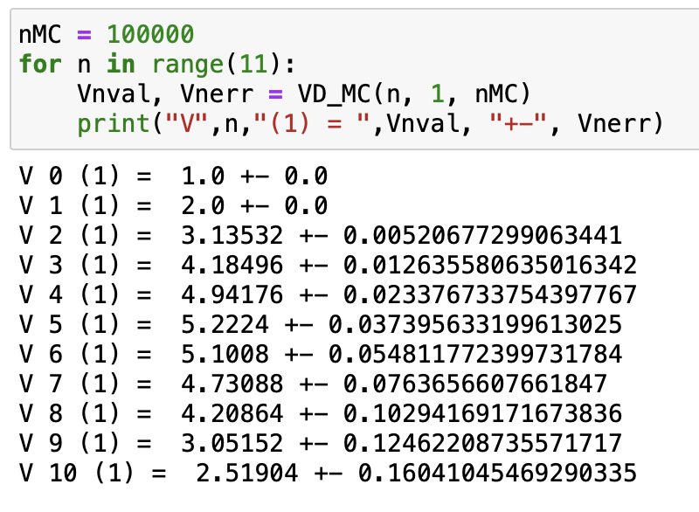
Volume of a D-dimensional ball (hypersphere)

Slide 11
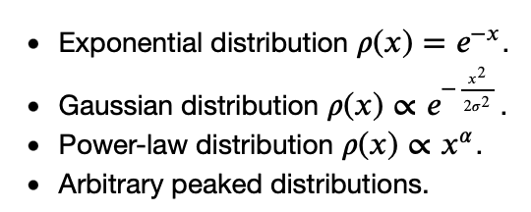
Nonuniformly distributed random numbers
In many cases we deal with random numbers $ξ$ that are distributed non-uniformly.
Common examples are:
There are two common methods for generating nonuniform random variates. They both make use of uniformly distributed variates.
Inverse transform sampling
Rejection sampling

Slide 12
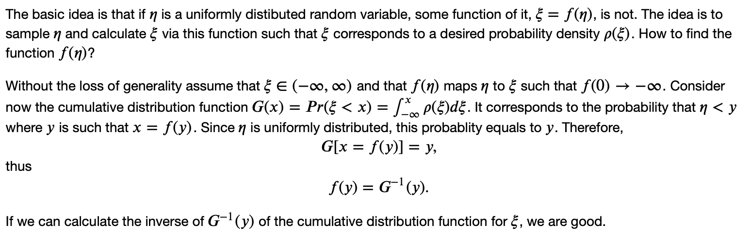
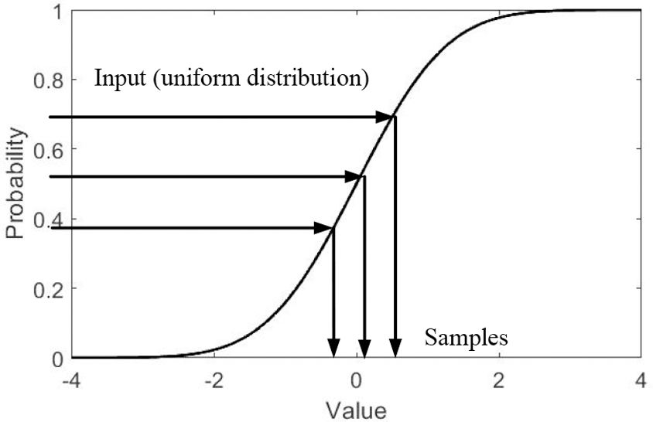
Inverse transform sampling

Slide 13
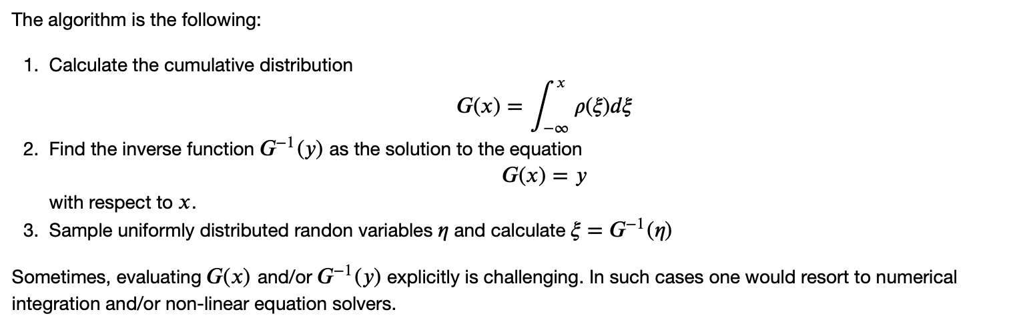
Inverse transform sampling

Slide 14
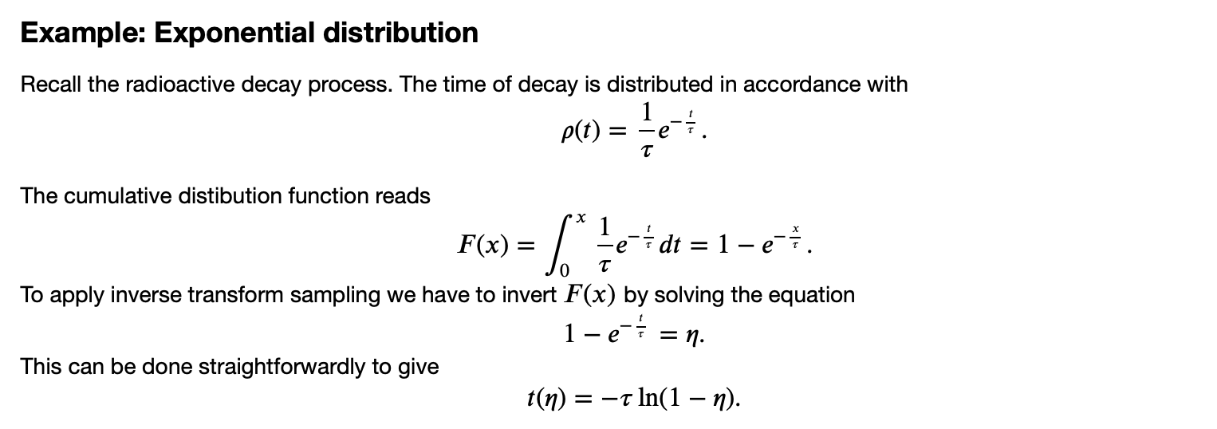
Inverse transform sampling

Slide 15
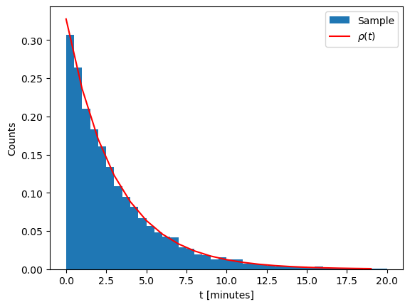
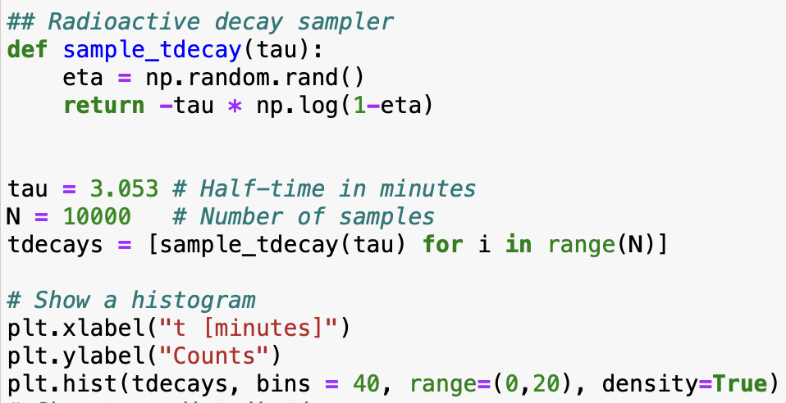
Sampling radioactive decay time

Slide 16
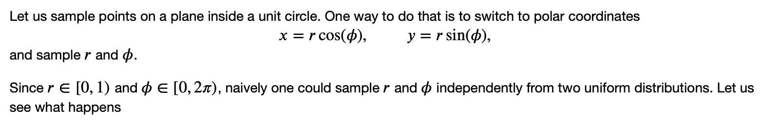
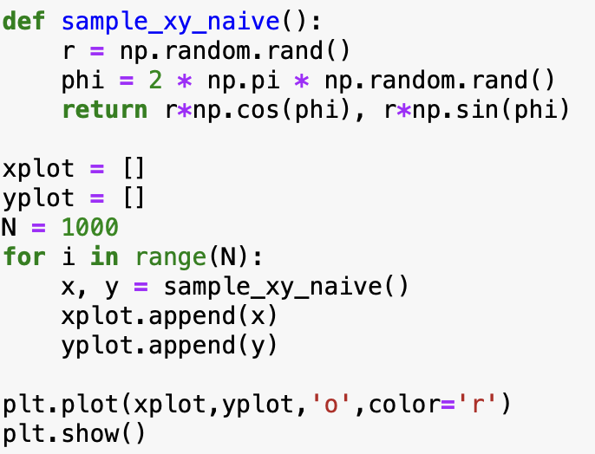
Sampling points inside a circle

Slide 17
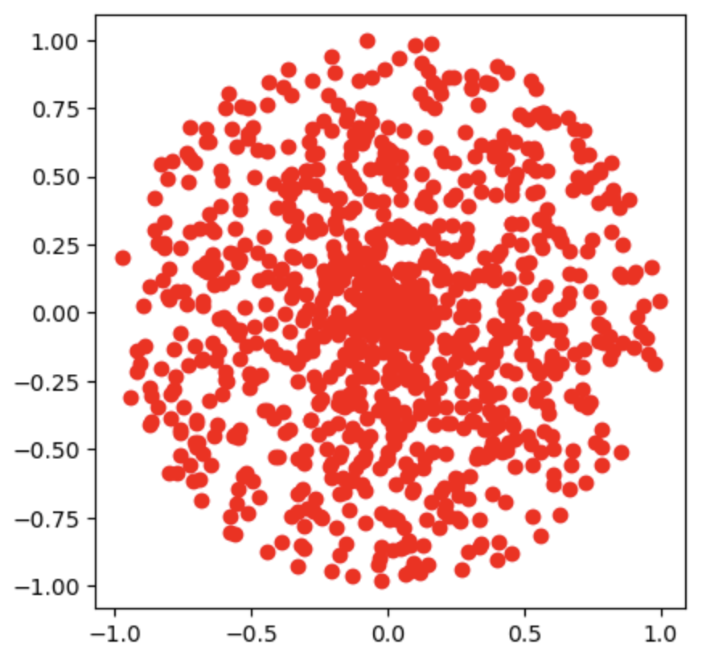
Sampling points inside a circle
The points clump more in the center!

Slide 18
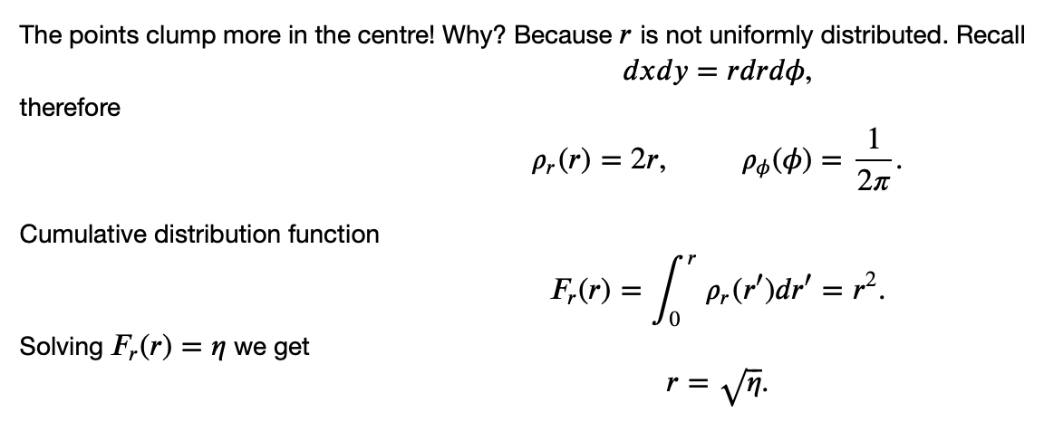
Sampling points inside a circle

Slide 19
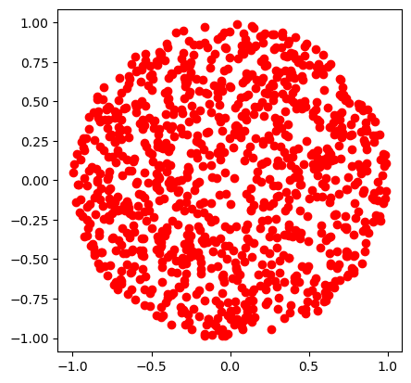
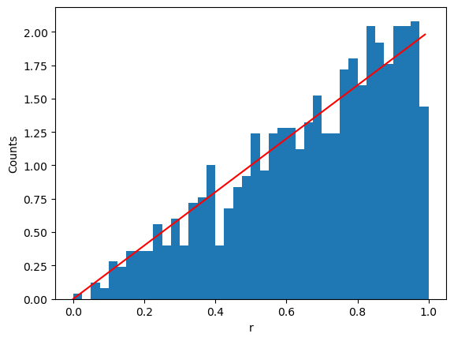
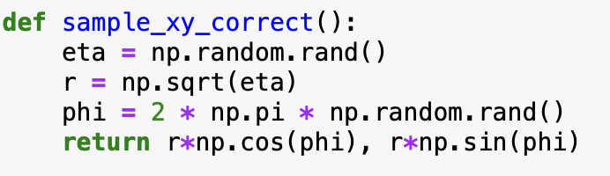
Sampling points inside a circle

Slide 20
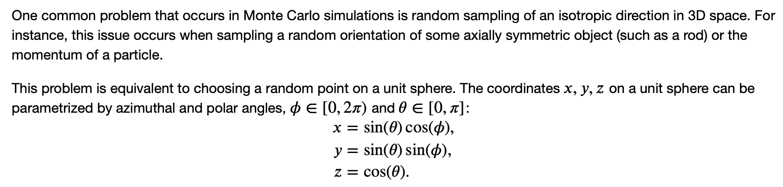
Sampling an isotropic direction

Slide 21
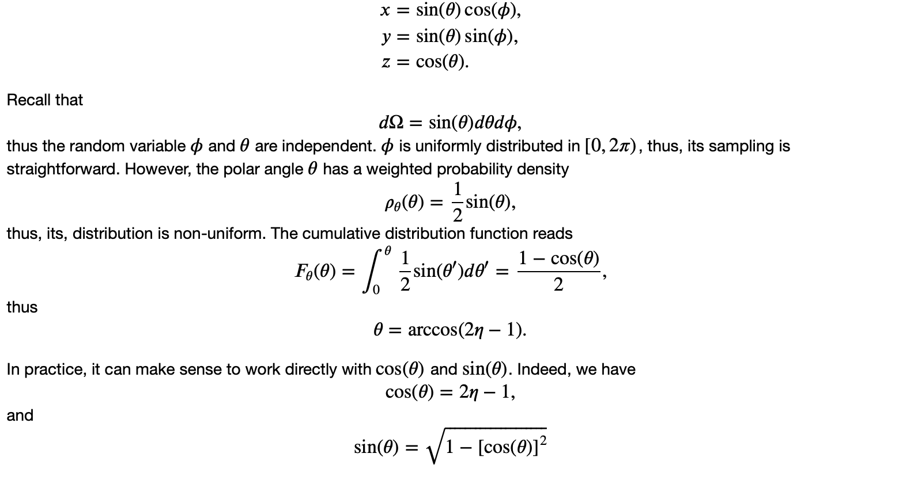
Sampling an isotropic direction

Slide 22
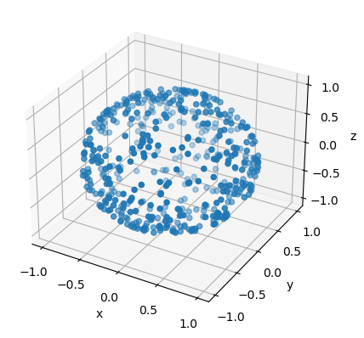
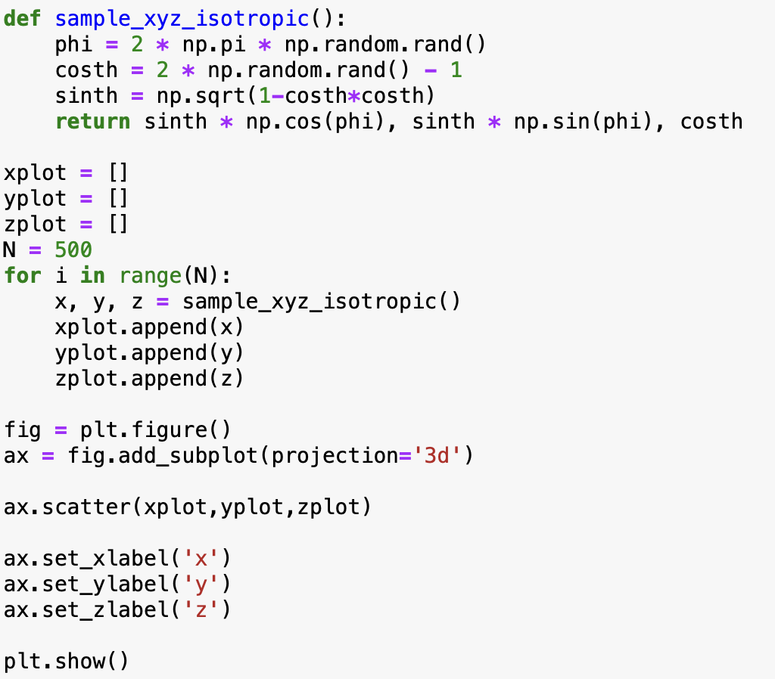
Sampling an isotropic direction

Slide 23
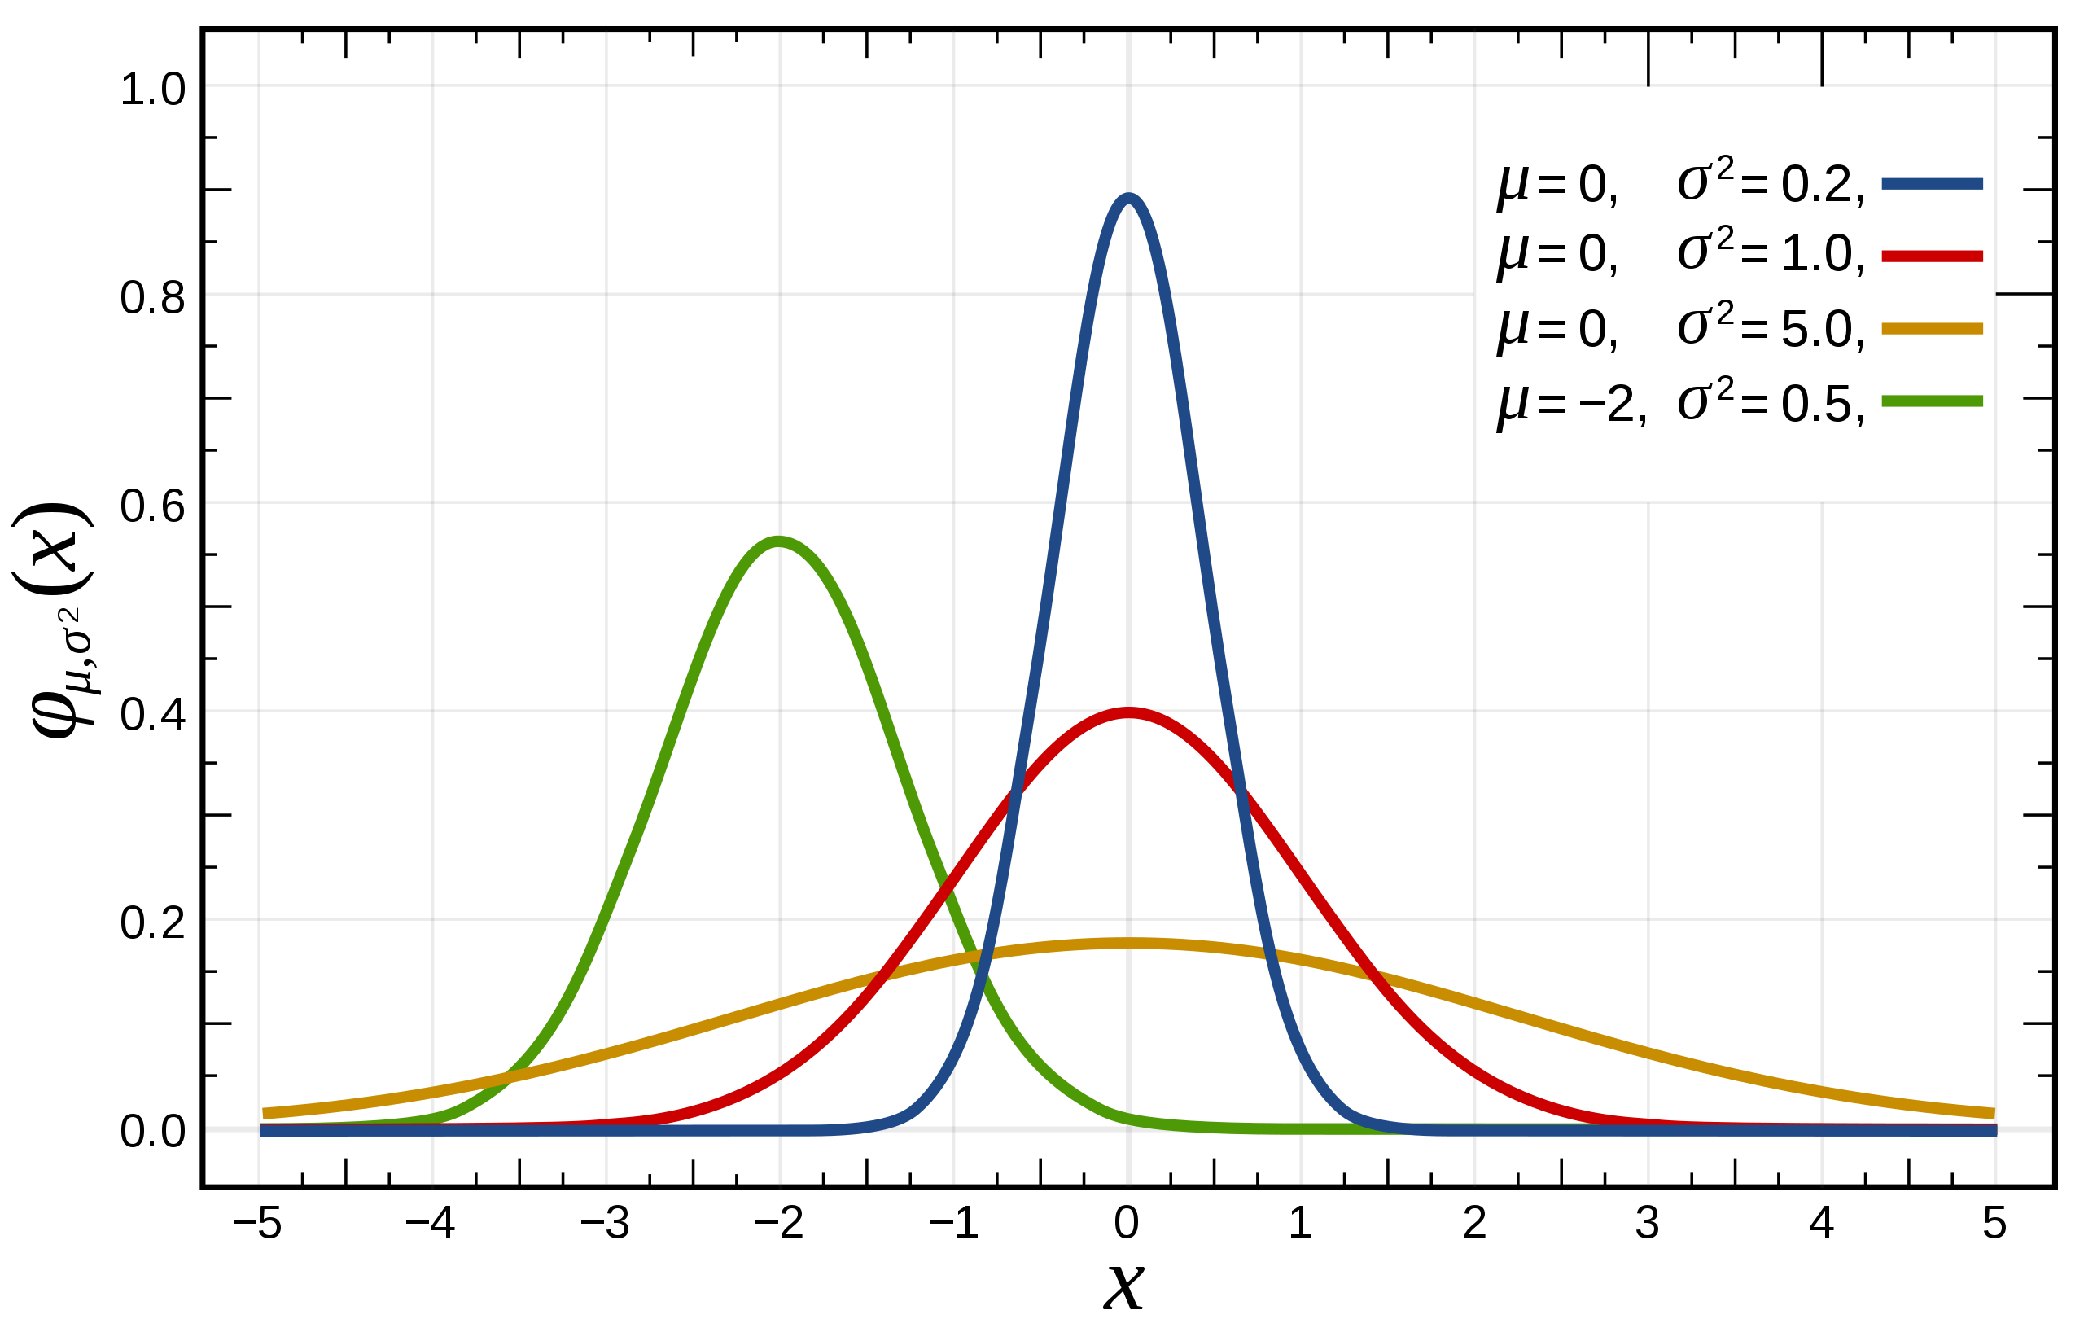
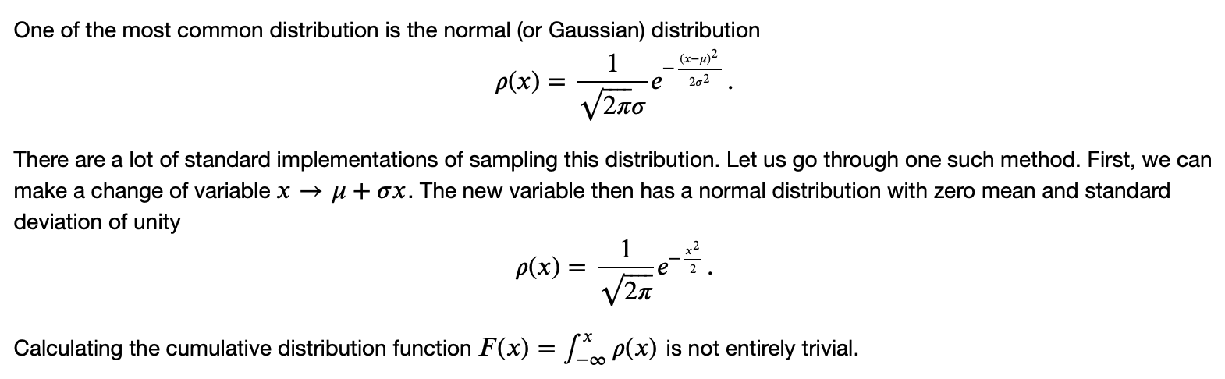
Sampling normally distributed variables

Slide 24
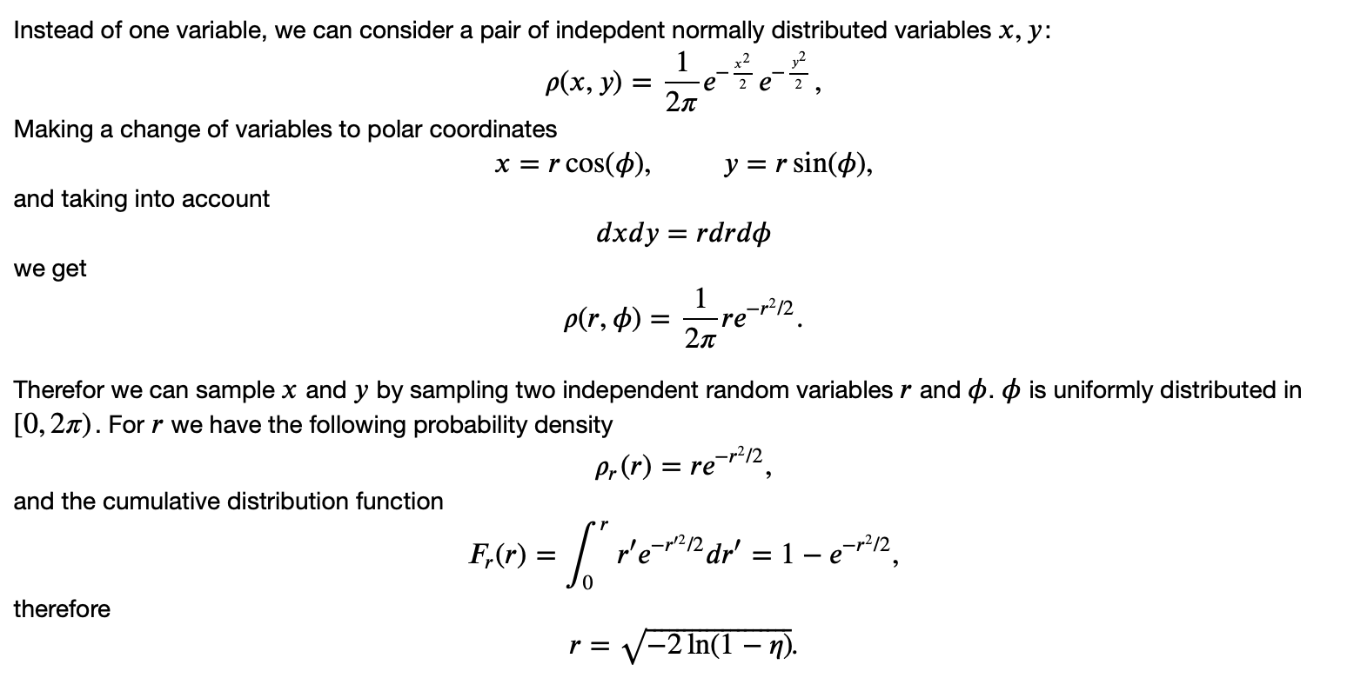
Sampling normally distributed variables

Slide 25
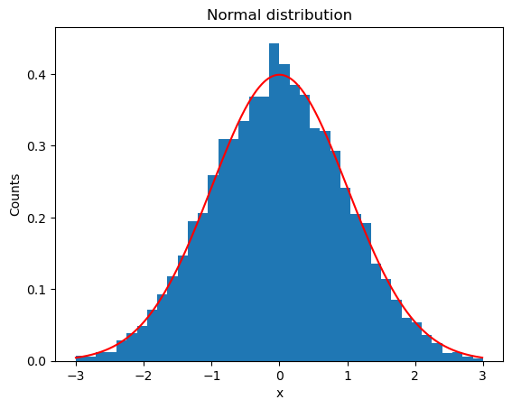
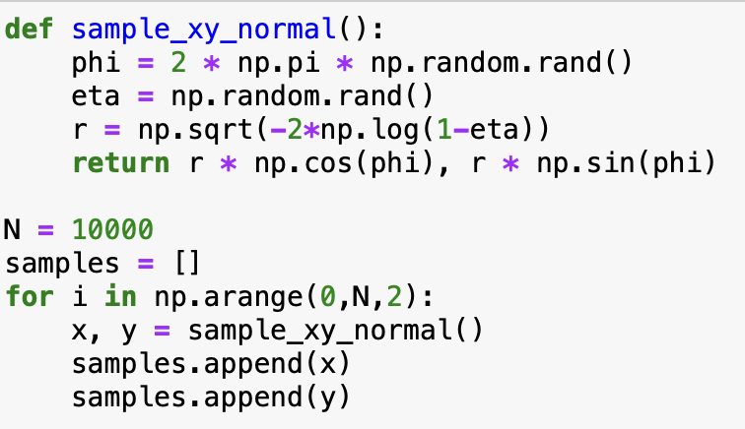
Sampling normally distributed variables

Slide 26
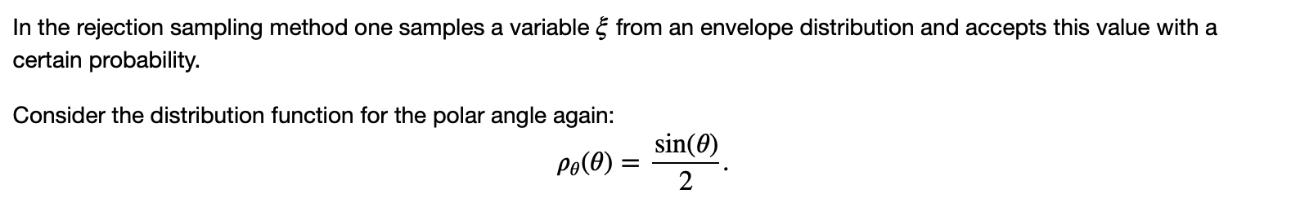
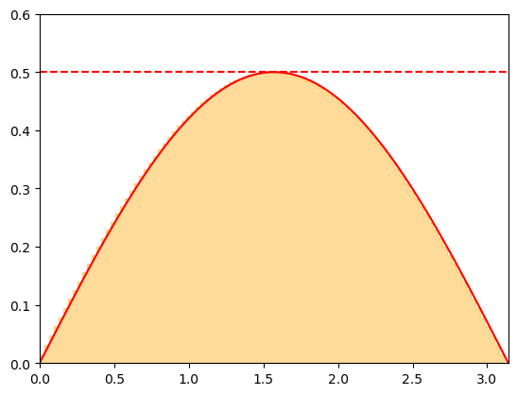
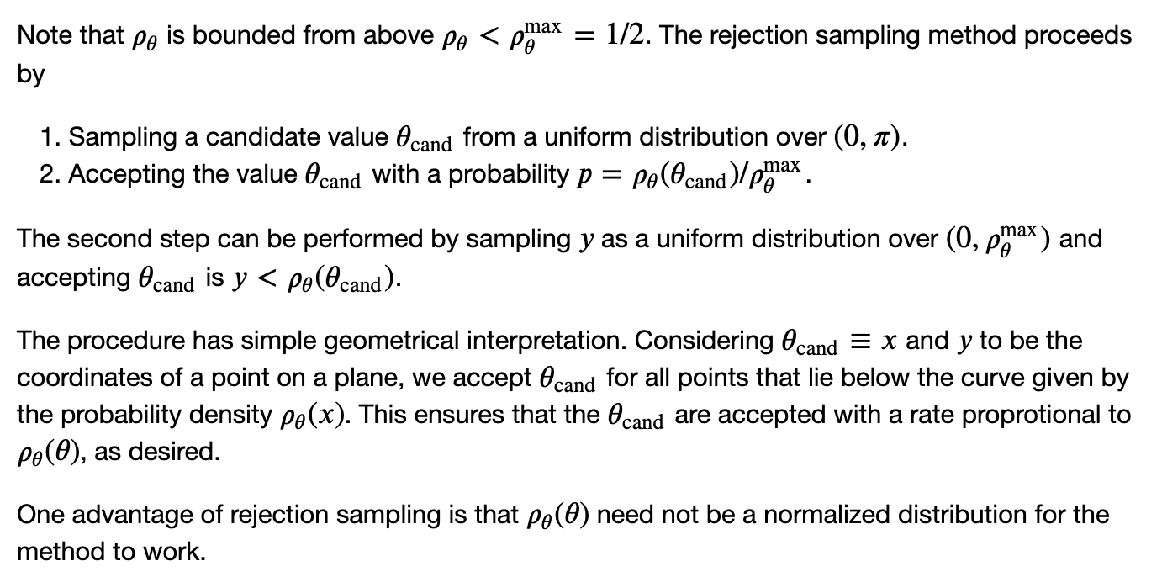
Rejection sampling

Slide 27
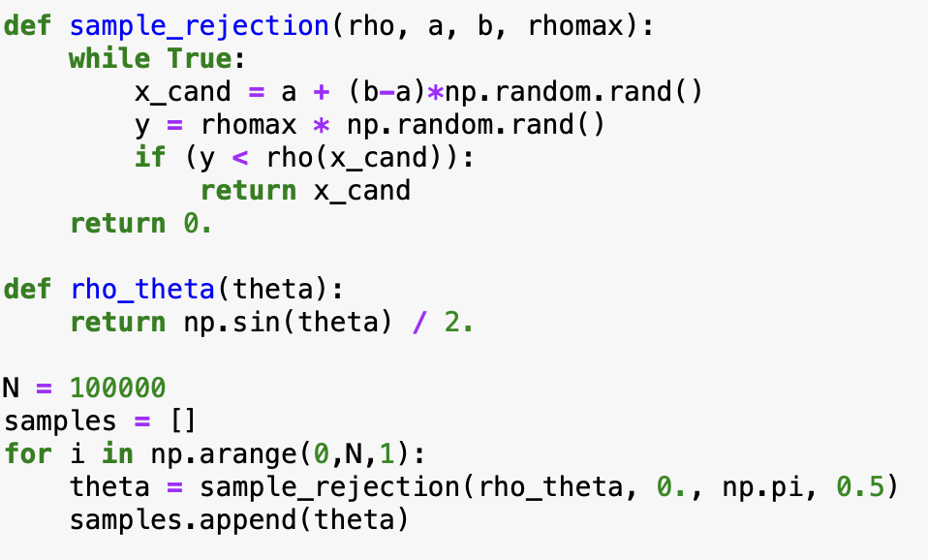

Rejection sampling

Slide 28

Rejection sampling

Slide 29







Importance sampling
Recall the calculation of an integral as statistical average
where
Some issues with the method:
Sample unimportant regions (e.g. f is highly peaked)
Integrable singularities
Importance sampling:
Sample $x_{i}$ from a non-uniform distribution w(x) that resembles f(x).
The integrand is then calculated as
Normalization:
Error:

Slide 30

Importance sampling
For w(x)=1/(b-a) we recover the mean value method
For w(x) $∝$ f(x) one has $\left\langle \frac{f(x)}{w(x)}\right\rangle$ = const = I and $δI=0$

Slide 31

Importance sampling

Slide 32


Importance sampling: Example
Integrable singularity at x=0

Slide 33








Importance sampling: Example
Mean value method
Importance sampling
f(x)/w(x)
Statistical error is more than x10 smaller than in the mean value method.
We would need more than x100 samples in the mean value method to reach the same accuracy as importance sampling in this case.

